Slide 1
第七章 蚁群优化算法

Slide 2
一.导言
起源
Ant Colony Optimization (ACO)
意大利学者Dorigo于1992年提出
其灵感来源于蚂蚁在寻找食物过程中发现路径的行为

Slide 3
一.导言
起源
蚂蚁的社会行为—共识主动性(Stigmergy)
真实蚂蚁几乎是全盲的
蚂蚁可以通过一种特有分泌物（信息素）的气味进行间接通信
当一只蚂蚁发现食物时，它就会在回家的路上留下一路的气味，其他的蚂蚁就会沿着这条路线去找食物，并不断地加强气味。如果食物被采集完了，没有蚂蚁再来，气味就会逐渐消散。

Slide 4
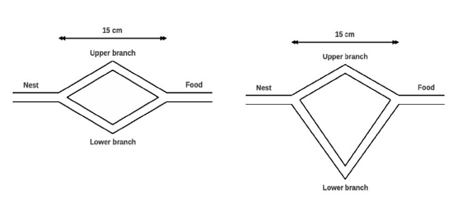
一.导言
一个小例子

Slide 5
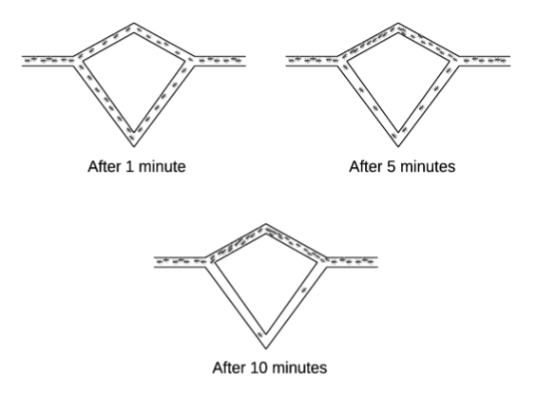
一.导言
一个小例子
不等分支时，蚂蚁很快聚集到短路径分支

Slide 6
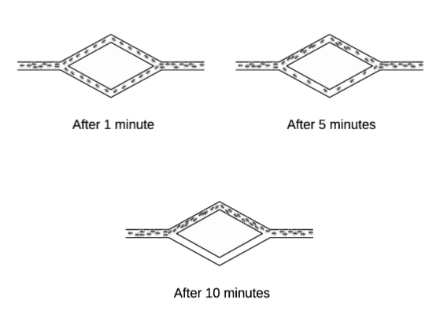
一.导言
一个小例子
相等分支时，蚂蚁最终聚集到一个分支
After 1 minutes
After 10 minutes
After 20 minutes

Slide 7
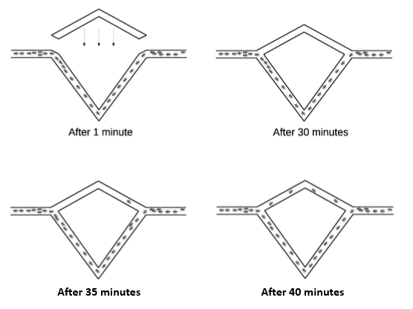
一.导言
一个小例子
收敛后提供最短分支时，最短分支仅是偶尔被选择

Slide 8
一.导言
基本思想
从真实蚂蚁到人工蚂蚁
优化：能够发现最短路径
探索能力：即使群体收敛于一条路径，仍然会有少量蚂蚁随机地选择别的路径
开发能力：大部分蚂蚁更愿意选择并收敛于信息素浓度大的路径
记忆性：蚂蚁移动时会用信息素标记走过的路径
迭代：多次往返巢穴和食物源

Slide 9
二.基本算法
ACO metaheuristic
A swarm intelligence algorithm rather than evolutionary algorithm
Does not use any search operators inspired by evolution
Inspired by the collective behavior of ant colonies
A population of ants interacts locally with each other and with their environment

Slide 10
二.基本算法
ACO metaheuristic
Developed especially for discrete/combinatorial optimization problems
The problem consists of finite set of components
Initial application: TSP
Consists of two main procedures: Construct Solutions (Forward Mode) and Pheromone Update (Backward Mode)

Slide 11
二.基本算法
ACO for TSP
ACO can be applied to TSP easily
Pheromone trails are associated with the arcs
Initially all pheromone trails are equal
Based on the length of a tour generated by the nearest-neighbor heuristic
Each ant is placed to a city randomly
Ants construct a feasible solution by adding cities to its memory until all cities are visited

Slide 12
二.基本算法
ACO for TSP
The construction procedure is based on a probabilistic rule
Uses existing pheromone trails and heuristic information
Heuristic information = the inverse of the cities’ distance
After all ants finish the construction procedure, the path is retraced and update the pheromone trails accordingly

Slide 13
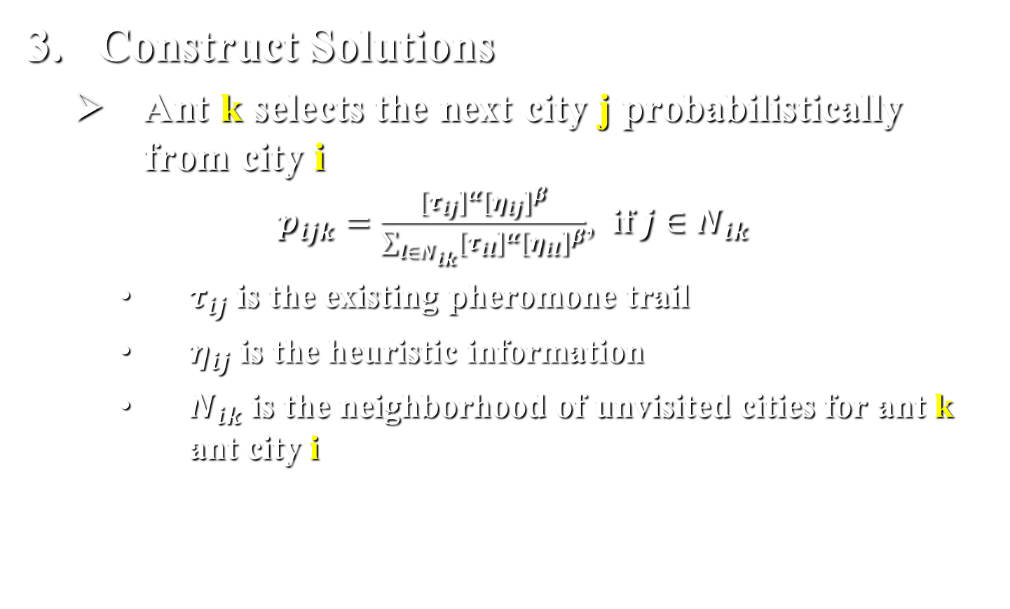
二.基本算法
Construct Solutions
Ant k selects the next city j probabilistically from city i
$p_{ijk}=\frac{{[τ_{ij}]}^{α}{[η_{ij}]}^{β}}{\sum_{l∈N_{ik}}{{[τ_{il}]}^{α}{[η_{il}]}^{β}}}$, if $j∈N_{ik}$
$τ_{ij}$ is the existing pheromone trail
$η_{ij}$ is the heuristic information
$N_{ik}$ is the neighborhood of unvisited cities for ant k ant city i

Slide 14
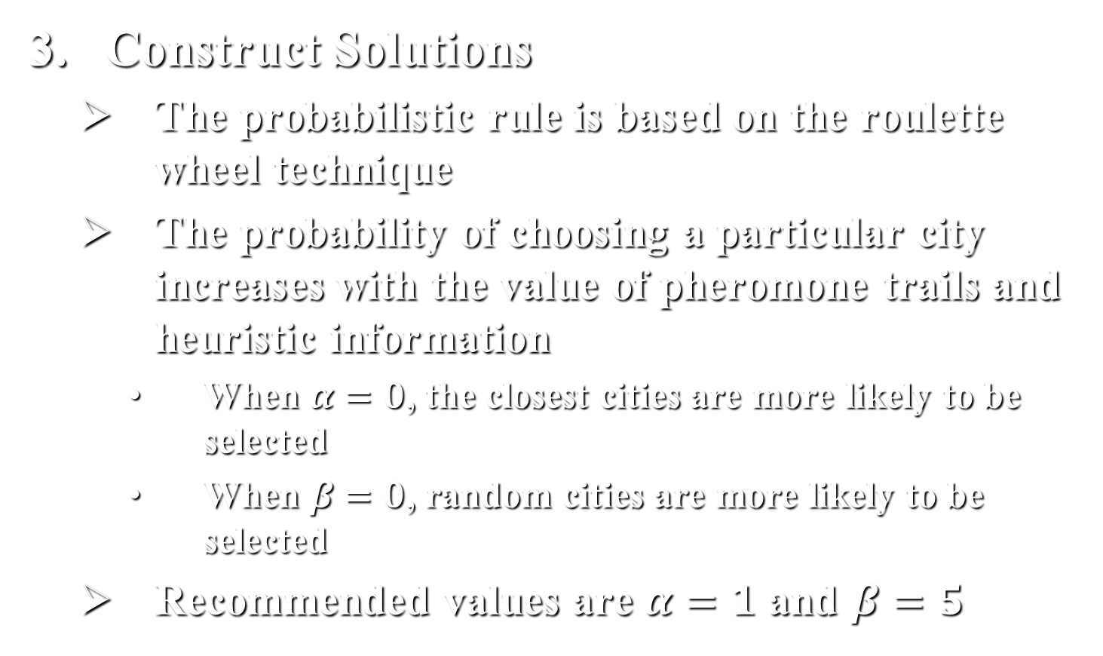
二.基本算法
Construct Solutions
The probabilistic rule is based on the roulette wheel technique
The probability of choosing a particular city increases with the value of pheromone trails and heuristic information
When $α=0$, the closest cities are more likely to be selected
When $β=0$, random cities are more likely to be selected
Recommended values are $α=1$ and $β=5$

Slide 15
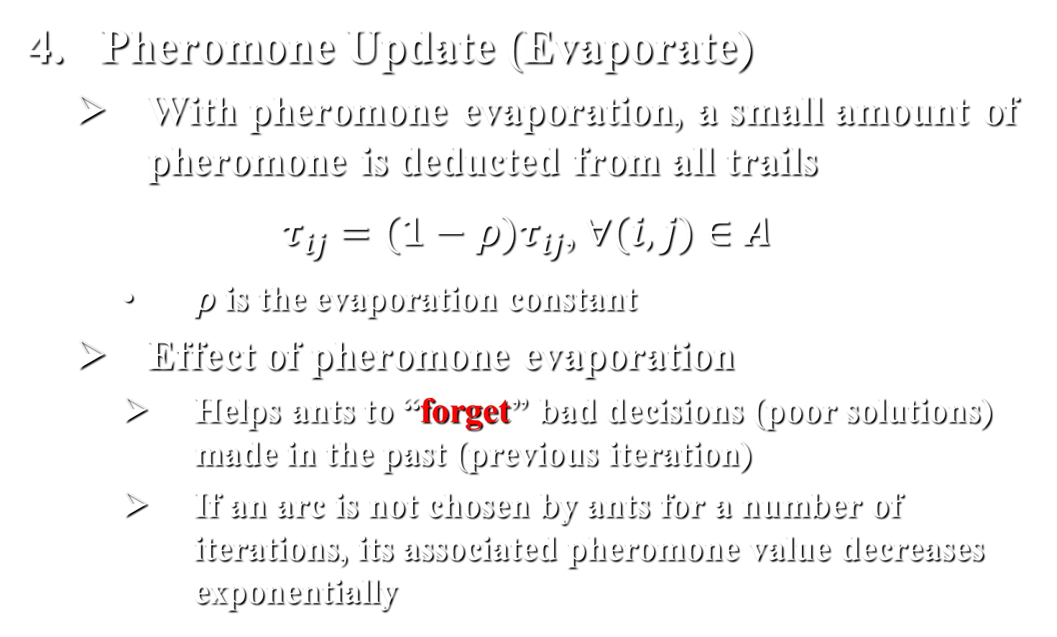
二.基本算法
Pheromone Update (Evaporate)
With pheromone evaporation, a small amount of pheromone is deducted from all trails
$τ_{ij}=(1−ρ)τ_{ij}$, $∀(i,j)∈A$
$ρ$ is the evaporation constant
Effect of pheromone evaporation
Helps ants to “forget” bad decisions (poor solutions) made in the past (previous iteration)
If an arc is not chosen by ants for a number of iterations, its associated pheromone value decreases exponentially

Slide 16

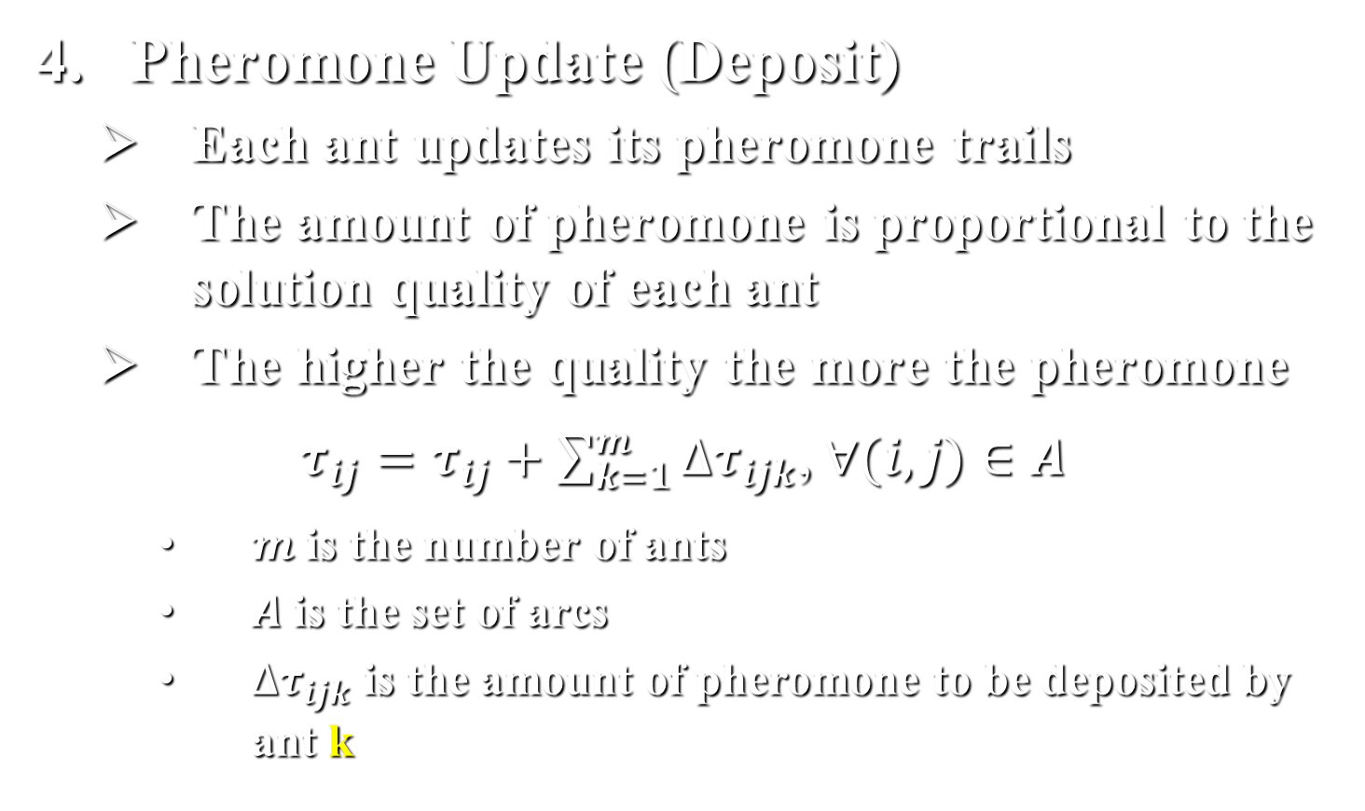
二.基本算法
Pheromone Update (Deposit)
Each ant updates its pheromone trails
The amount of pheromone is proportional to the solution quality of each ant
The higher the quality the more the pheromone
$τ_{ij}=τ_{ij}+\sum_{k=1}^{m}{∆τ_{ijk}}$, $∀(i,j)∈A$
$m$ is the number of ants
$A$ is the set of arcs
$∆τ_{ijk}$ is the amount of pheromone to be deposited by ant k

Slide 17
三.应用算例
ACO in Action
TSP with 5 cities
ACO with 2 ants
Distance Matrix
ID | 1 | 2 | 3 | 4 | 5
1 | - | 6 | 3 | 8 | 7
2 | 6 | - | 4 | 5 | 2
3 | 3 | 4 | - | 3 | 1
4 | 8 | 5 | 3 | - | 8
5 | 7 | 2 | 1 | 8 | -

Slide 18
三.应用算例
Initial Phase
Initial values of pheromone are set to 0.5
Heuristic Matrix
Pheromone Matrix
ID | 1 | 2 | 3 | 4 | 5
1 | - | 0.16 | 0.33 | 0.12 | 0.14
2 | 0.16 | - | 0.25 | 0.20 | 0.50
3 | 0.33 | 0.25 | - | 0.33 | 1.00
4 | 0.12 | 0.20 | 0.33 | - | 0.12
5 | 0.14 | 0.50 | 1.00 | 0.12 | -
ID | 1 | 2 | 3 | 4 | 5
1 | - | 0.5 | 0.5 | 0.5 | 0.5
2 | 0.5 | - | 0.5 | 0.5 | 0.5
3 | 0.5 | 0.5 | - | 0.5 | 0.5
4 | 0.5 | 0.5 | 0.5 | - | 0.5
5 | 0.5 | 0.5 | 0.5 | 0.5 | -

Slide 19
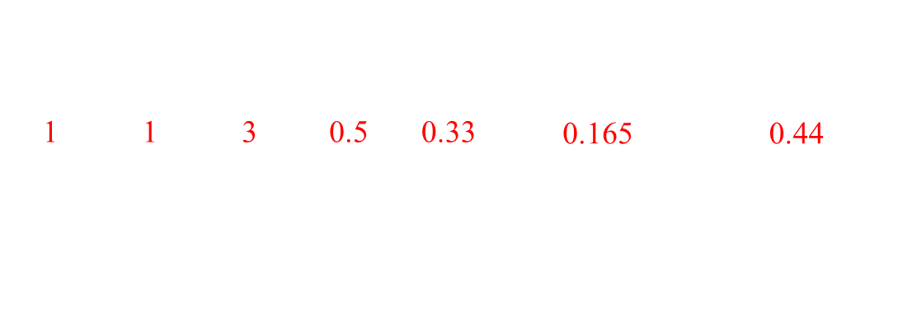
三.应用算例
First Iteration
Ant 1：How to construct a tour (Forward Mode)
Step 1: start from city 1 randomly;
Step 2: select the next city to visit from city 1;
$$k$$ | $$i$$ | $$j$$ | $$τ_{ij}$$ | $$η_{ij}$$ | $$τ_{ij}∙η_{ij}$$ | $$p_{ijk}$$
1 | 1 | 2 | 0.5 | 0.16 | 0.08 | 0.21
1 | 1 | 3 | 0.5 | 0.33 | 0.165 | 0.44
1 | 1 | 4 | 0.5 | 0.12 | 0.06 | 0.16
1 | 1 | 5 | 0.5 | 0.14 | 0.07 | 0.19
Sum |  |  |  |  | 0.375 | 1.00
Here, city 3 is chosen by Ant 1 as the next city to visit from city 1

Slide 20
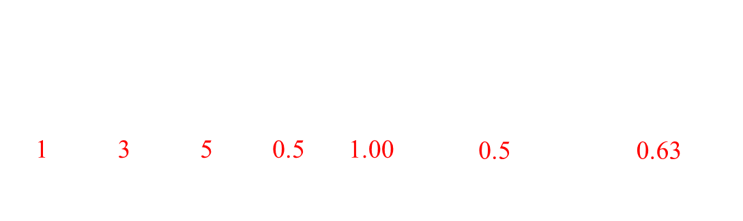
三.应用算例
First Iteration
Ant 1：How to construct a tour (Forward Mode)
Step 3: select the next city to visit from city 3;
$$k$$ | $$i$$ | $$j$$ | $$τ_{ij}$$ | $$η_{ij}$$ | $$τ_{ij}∙η_{ij}$$ | $$p_{ijk}$$
1 | 3 | 2 | 0.5 | 0.25 | 0.125 | 0.16
1 | 3 | 4 | 0.5 | 0.33 | 0.165 | 0.21
1 | 3 | 5 | 0.5 | 1.00 | 0.5 | 0.63
Sum |  |  |  |  | 0.79 | 1.00
Here, city 5 is chosen by Ant 1 as the next city to visit from city 3

Slide 21
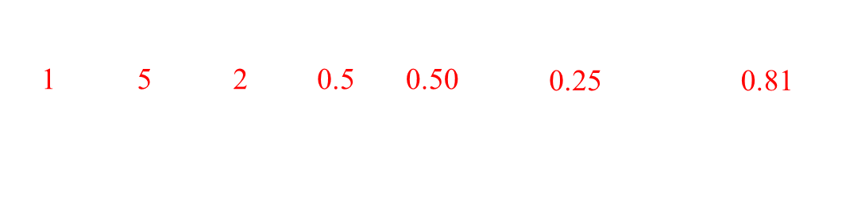
三.应用算例
First Iteration
Ant 1：How to construct a tour (Forward Mode)
Step 4: select the next city to visit from city 5;
$$k$$ | $$i$$ | $$j$$ | $$τ_{ij}$$ | $$η_{ij}$$ | $$τ_{ij}∙η_{ij}$$ | $$p_{ijk}$$
1 | 5 | 2 | 0.5 | 0.50 | 0.25 | 0.81
1 | 5 | 4 | 0.5 | 0.12 | 0.06 | 0.19
Sum |  |  |  |  | 0.31 | 1.00
Here, city 2 is chosen by Ant 1 as the next city to visit from city 5

Slide 22
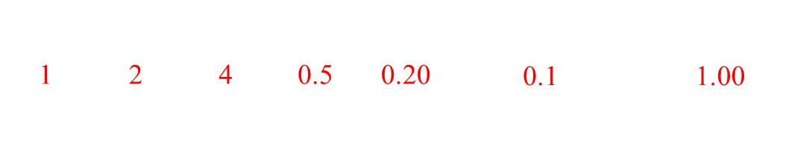
三.应用算例
First Iteration
Ant 1：How to construct a tour (Forward Mode)
Step 5: select the next city to visit from city 2;
$$k$$ | $$i$$ | $$j$$ | $$τ_{ij}$$ | $$η_{ij}$$ | $$τ_{ij}∙η_{ij}$$ | $$p_{ijk}$$
1 | 2 | 4 | 0.5 | 0.20 | 0.1 | 1.00
Sum |  |  |  |  | 0.1 | 1.00
Here, city 4 is chosen by Ant 1 as the next city to visit from city 2
Therefore, Ant 1 can construct a tour: 1-3-5-2-4-1. The distance value of this tour is: 19

Slide 23
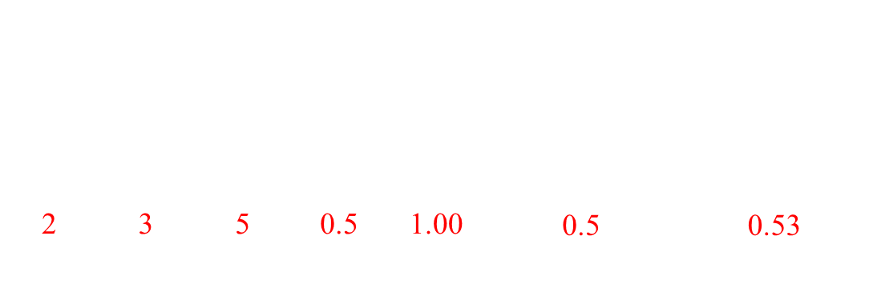
三.应用算例
First Iteration
Ant 2：How to construct a tour (Forward Mode)
Step 1: start from city 3 randomly;
Step 2: select the next city to visit from city 3;
$$k$$ | $$i$$ | $$j$$ | $$τ_{ij}$$ | $$η_{ij}$$ | $$τ_{ij}∙η_{ij}$$ | $$p_{ijk}$$
2 | 3 | 1 | 0.5 | 0.33 | 0.165 | 0.17
2 | 3 | 2 | 0.5 | 0.25 | 0.125 | 0.13
2 | 3 | 4 | 0.5 | 0.33 | 0.165 | 0.17
2 | 3 | 5 | 0.5 | 1.00 | 0.5 | 0.53
Sum |  |  |  |  | 0.955 | 1.00
Here, city 5 is chosen by Ant 2 as the next city to visit from city 3

Slide 24
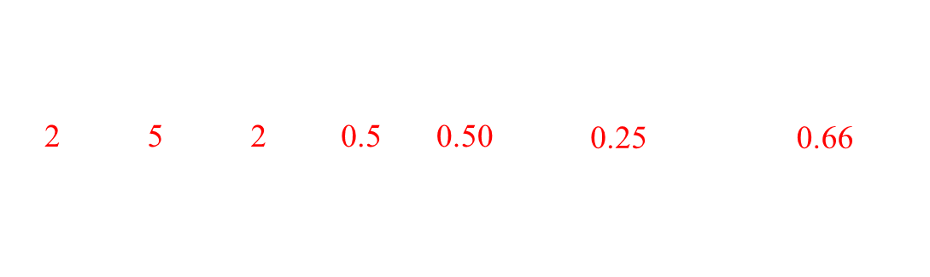
三.应用算例
First Iteration
Ant 2：How to construct a tour (Forward Mode)
Step 3: select the next city to visit from city 5;
$$k$$ | $$i$$ | $$j$$ | $$τ_{ij}$$ | $$η_{ij}$$ | $$τ_{ij}∙η_{ij}$$ | $$p_{ijk}$$
2 | 5 | 1 | 0.5 | 0.14 | 0.07 | 0.18
2 | 5 | 2 | 0.5 | 0.50 | 0.25 | 0.66
2 | 5 | 4 | 0.5 | 0.12 | 0.06 | 0.16
Sum |  |  |  |  | 0.38 | 1.00
Here, city 2 is chosen by Ant 2 as the next city to visit from city 5

Slide 25
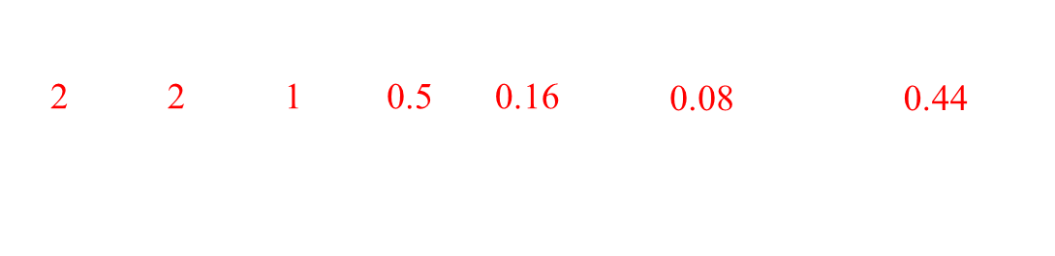
三.应用算例
First Iteration
Ant 2：How to construct a tour (Forward Mode)
Step 4: select the next city to visit from city 2;
$$k$$ | $$i$$ | $$j$$ | $$τ_{ij}$$ | $$η_{ij}$$ | $$τ_{ij}∙η_{ij}$$ | $$p_{ijk}$$
2 | 2 | 1 | 0.5 | 0.16 | 0.08 | 0.44
2 | 2 | 4 | 0.5 | 0.20 | 0.1 | 0.56
Sum |  |  |  |  | 0.18 | 1.00
Here, city 1 is chosen by Ant 2 as the next city to visit from city 2

Slide 26
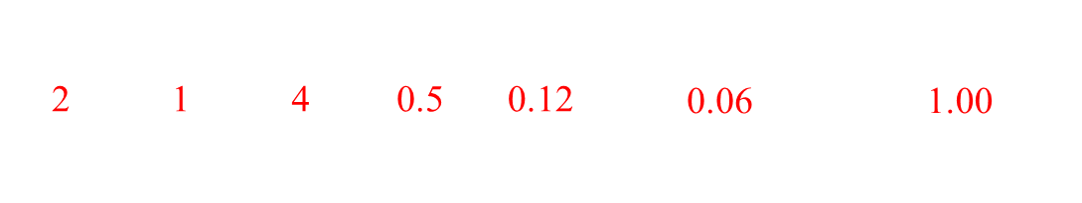
三.应用算例
First Iteration
Ant 2：How to construct a tour (Forward Mode)
Step 5: select the next city to visit from city 2;
$$k$$ | $$i$$ | $$j$$ | $$τ_{ij}$$ | $$η_{ij}$$ | $$τ_{ij}∙η_{ij}$$ | $$p_{ijk}$$
2 | 1 | 4 | 0.5 | 0.12 | 0.06 | 1.00
Sum |  |  |  |  | 0.06 | 1.00
Here, city 4 is chosen by Ant 2 as the next city to visit from city 1
Therefore, Ant 2 can construct a tour: 3-5-2-1-4-3. The distance value of this tour is: 20

Slide 27
三.应用算例
First Iteration
Update pheromone matrix (Backward Mode)
Step 1: Evaporation radio is 0.5
Pheromone Matrix after evaporation
ID | 1 | 2 | 3 | 4 | 5
1 | - | 0.25 | 0.25 | 0.25 | 0.25
2 | 0.25 | - | 0.25 | 0.25 | 0.25
3 | 0.25 | 0.25 | - | 0.25 | 0.25
4 | 0.25 | 0.25 | 0.25 | - | 0.25
5 | 0.25 | 0.25 | 0.25 | 0.25 | -

Slide 28

三.应用算例
First Iteration
Update pheromone matrix (Backward Mode)
Step 2: Update by ant 1 with $Δτ=0.053$
Pheromone Matrix after ant 1
ID | 1 | 2 | 3 | 4 | 5
1 | - | 0.25 | 0. 303 | 0.303 | 0.25
2 | 0.25 | - | 0.25 | 0.303 | 0.303
3 | 0. 303 | 0.25 | - | 0.25 | 0.303
4 | 0.303 | 0.303 | 0.25 | - | 0.25
5 | 0.25 | 0.303 | 0.303 | 0.25 | -
Ant 1 constructs a tour: 1-3-5-2-4-1, and the distance value of this tour is: 19.

Slide 29

三.应用算例
First Iteration
Update pheromone matrix (Backward Mode)
Step 3: Update by ant 2 with $Δτ=0.05$
Pheromone Matrix after ant 2
ID | 1 | 2 | 3 | 4 | 5
1 | - | 0.30 | 0. 303 | 0.353 | 0.25
2 | 0.30 | - | 0.25 | 0.303 | 0.353
3 | 0. 303 | 0.25 | - | 0.30 | 0.353
4 | 0.353 | 0.303 | 0.30 | - | 0.25
5 | 0.25 | 0.353 | 0.353 | 0.25 | -
Ant 2 constructs a tour: 3-5-2-1-4-3, and the distance value of this tour is: 20.

Slide 30
三.应用算例
First Iteration
Update pheromone matrix (Backward Mode)
Final Pheromone Matrix
ID | 1 | 2 | 3 | 4 | 5
1 | - | 0.30 | 0. 303 | 0.353 | 0.25
2 | 0.30 | - | 0.25 | 0.303 | 0.353
3 | 0. 303 | 0.25 | - | 0.30 | 0.353
4 | 0.353 | 0.303 | 0.30 | - | 0.25
5 | 0.25 | 0.353 | 0.353 | 0.25 | -

Slide 31
四.算法变型
ACO Variations
So far we described the basic version of ACO known as the Ant System (AS)
Several variations were proposed that mainly differ on the way pheromone trails are updated
Their objective is to address stagnation behavior
When all ants follow the same path early

Slide 32
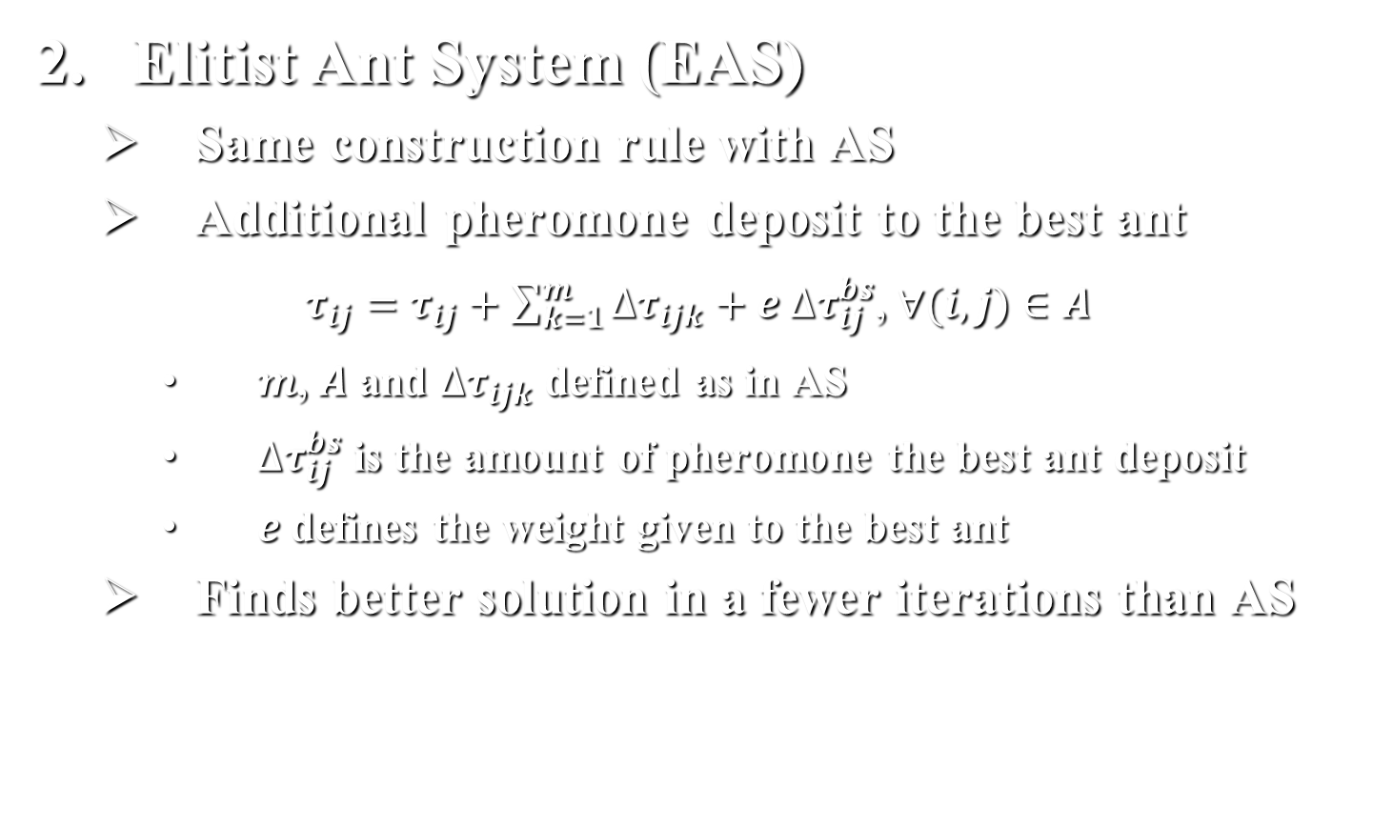
四.算法变型
Elitist Ant System (EAS)
Same construction rule with AS
Additional pheromone deposit to the best ant
$τ_{ij}=τ_{ij}+\sum_{k=1}^{m}{∆τ_{ijk}}+e ∆τ_{ij}^{bs}$, $∀(i,j)∈A$
$m$, $A$ and $∆τ_{ijk}$ defined as in AS
$∆τ_{ij}^{bs}$ is the amount of pheromone the best ant deposit
$e$defines the weight given to the best ant
Finds better solution in a fewer iterations than AS

Slide 33
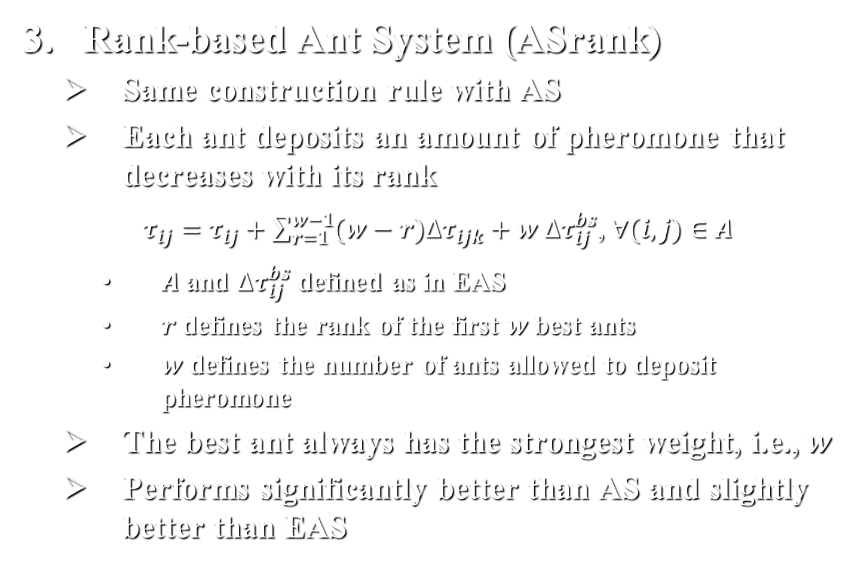
四.算法变型
Rank-based Ant System (ASrank)
Same construction rule with AS
Each ant deposits an amount of pheromone that decreases with its rank
$τ_{ij}=τ_{ij}+\sum_{r=1}^{w−1}{(w−r)∆τ_{ijk}}+w ∆τ_{ij}^{bs}$, $∀(i,j)∈A$
$A$ and $∆τ_{ij}^{bs}$ defined as in EAS
$r$ defines the rank of the first $w$best ants
$w$ defines the number of ants allowed to deposit pheromone
The best ant always has the strongest weight, i.e., $w$
Performs significantly better than AS and slightly better than EAS

Slide 34
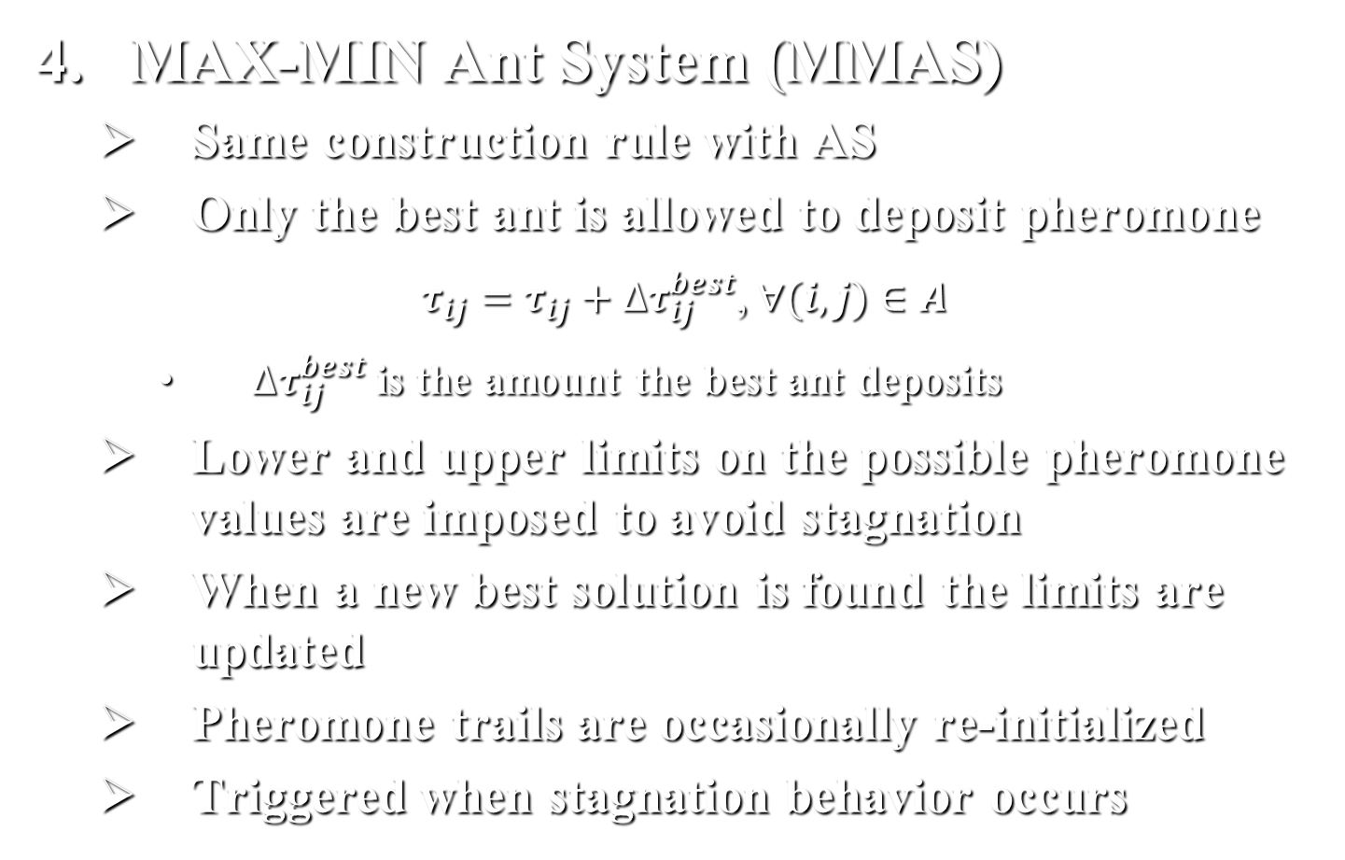
四.算法变型
MAX-MIN Ant System (MMAS)
Same construction rule with AS
Only the best ant is allowed to deposit pheromone
$τ_{ij}=τ_{ij}+∆τ_{ij}^{best}$, $∀(i,j)∈A$
$∆τ_{ij}^{best}$ is the amount the best ant deposits
Lower and upper limits on the possible pheromone values are imposed to avoid stagnation
When a new best solution is found the limits are updated
Pheromone trails are occasionally re-initialized
Triggered when stagnation behavior occurs

Slide 35
四.算法变型
Ant Colony System (ACS)
Different construction rule than the other variations
A new parameter q0 is introduced that allows to tune the exploration and exploitation
With probability 1-q0 the same probabilistic rule with AS is used
With probability q0 the next city with maximum probability is selected
q0 is set to 0.9 hence the 2nd option is frequently used

Slide 36
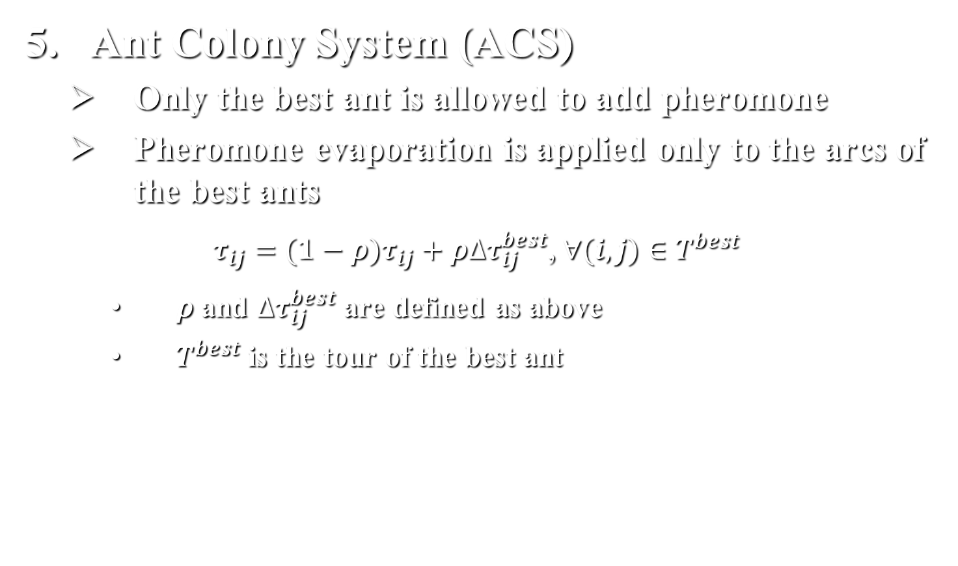
四.算法变型
Ant Colony System (ACS)
Only the best ant is allowed to add pheromone
Pheromone evaporation is applied only to the arcs of the best ants
$τ_{ij}=(1−ρ)τ_{ij}+ρ∆τ_{ij}^{best}$, $∀(i,j)∈T^{best}$
$ρ$ and $∆τ_{ij}^{best}$ are defined as above
$T^{best}$ is the tour of the best ant

Slide 37
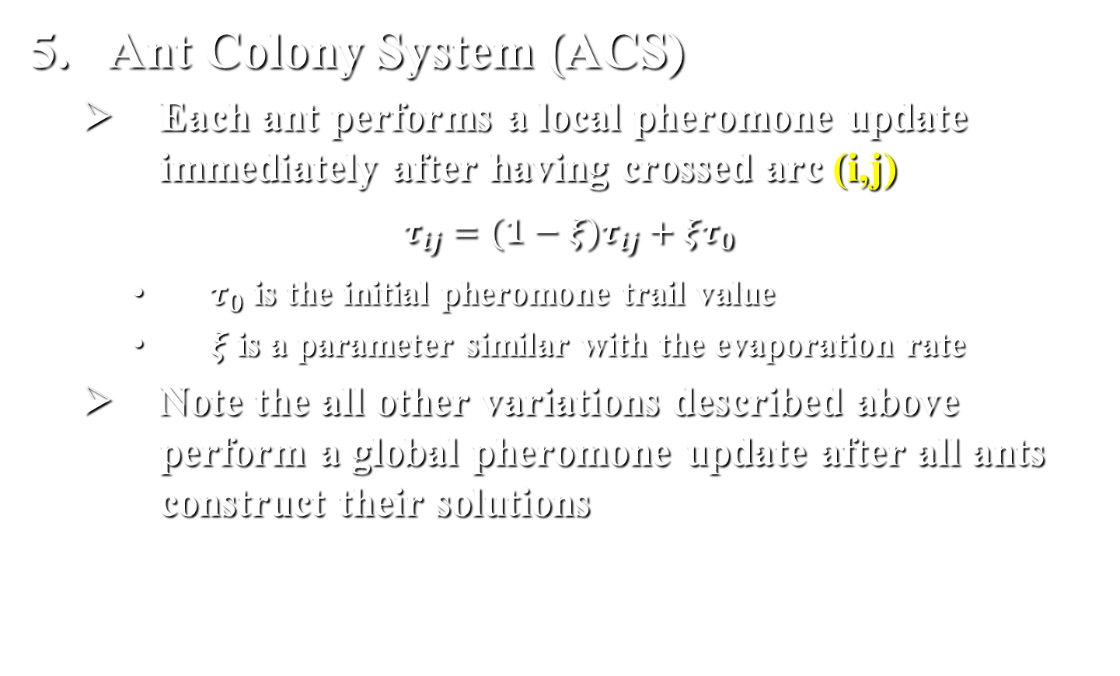
四.算法变型
Ant Colony System (ACS)
Each ant performs a local pheromone update immediately after having crossed arc (i,j)
$$τ_{ij}=(1−ξ)τ_{ij}+ξτ_{0}$$
$τ_{0}$ is the initial pheromone trail value
$ξ$ is a parameter similar with the evaporation rate
Note the all other variations described above perform a global pheromone update after all ants construct their solutions

Slide 38
四.算法变型
Population-based ACO (P-ACO)
Same construction rule with ACS
Uses an explicit memory that stores the best ant
“First in first out” policy is used to update memory
The pheromone trails are updated according to the ants currently stored in the memory

Slide 39
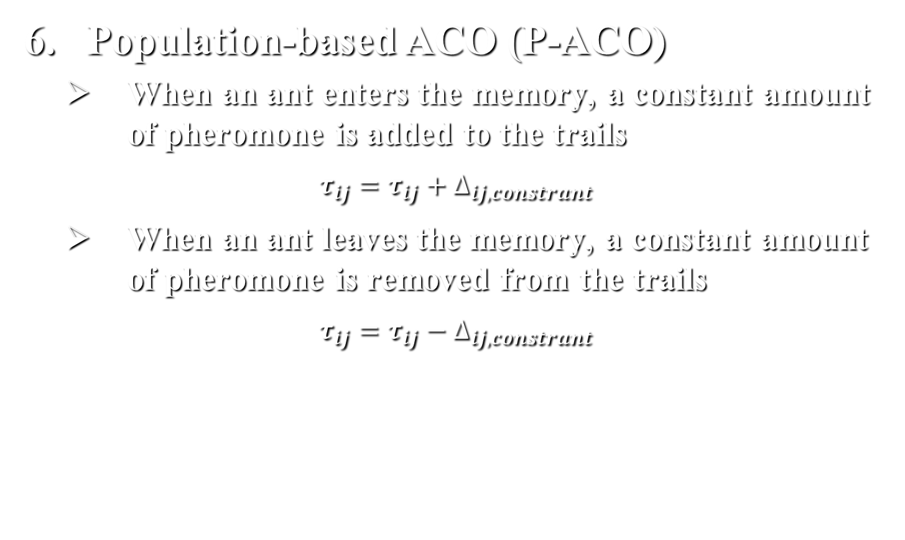
四.算法变型
Population-based ACO (P-ACO)
When an ant enters the memory, a constant amount of pheromone is added to the trails
$$τ_{ij}=τ_{ij}+∆_{ij,constrant}$$
When an ant leaves the memory, a constant amount of pheromone is removed from the trails
$$τ_{ij}=τ_{ij}−∆_{ij,constrant}$$

Slide 40
四.算法变型
Remarks on the Variations
ACS uses a more greedy probabilistic rule
Local pheromone update is closer to the behavior of real ants that deposit pheromone as they are moving
ACS and MMAS are the state-of-the-art ACO algorithms
P-ACO is competitive with MMAS
P-ACO does not use any pheromone evaporation; trails are removed directly
MMAS explicitly imposes pheromone trail limits whereas ACS and P-ACO implicitly impose pheromone trail limits

